Slide 1
Group 10
Sprint2

Slide 2
Progress
GANTT Chart
Front-end user interface (designs, fields and buttons)
Back-end (partial completion of coding)
Completion of the updated backend architecture
Database Relationship and keys (Primary and Foreign)
Update Admins JSPs for their view and adding new drivers
Update Customers JSPs - for viewing, requesting a taxi, inputting needed details
Update Drivers JSP- for viewing completed jobs and viewing driver details.
Presentation for Sprint 2

Slide 3
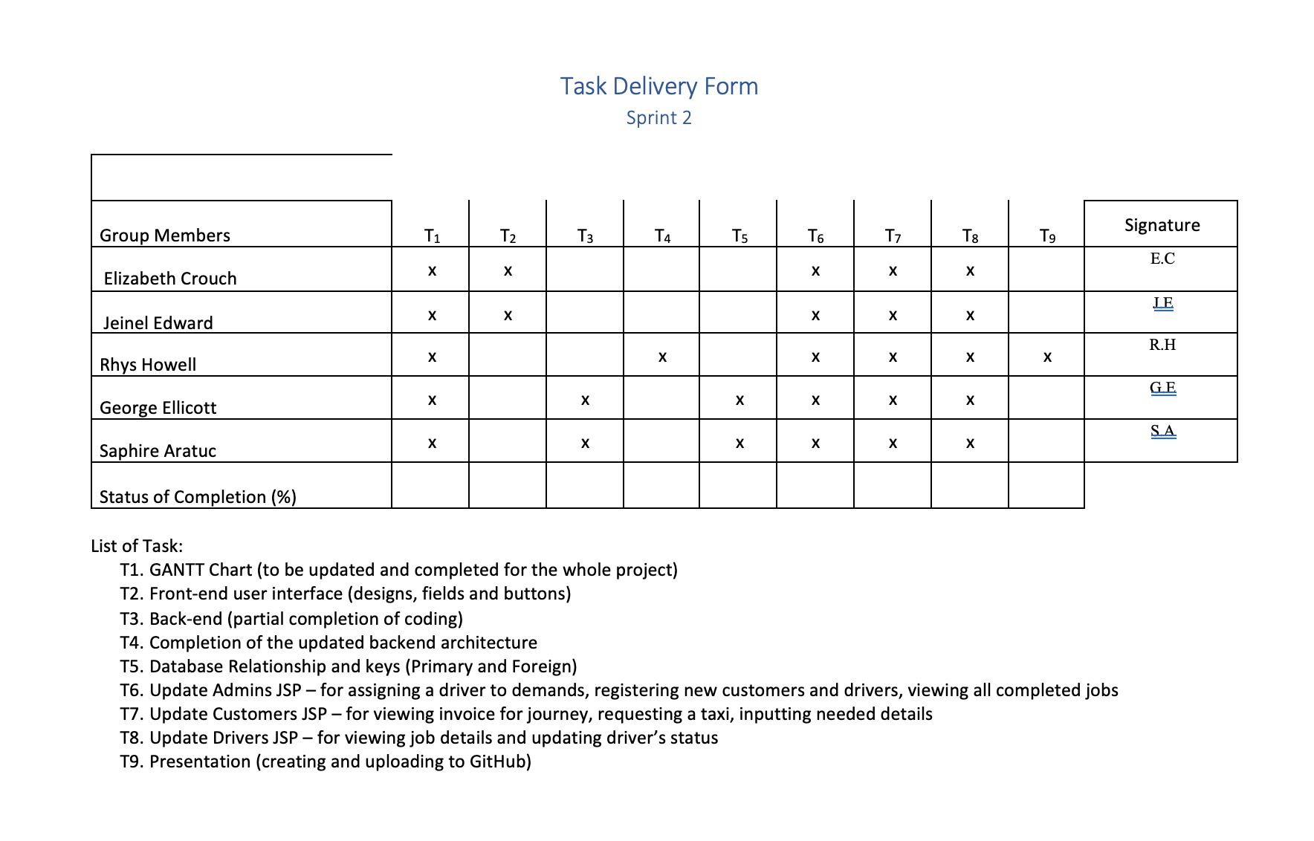
Roles and task Allocation

Slide 4
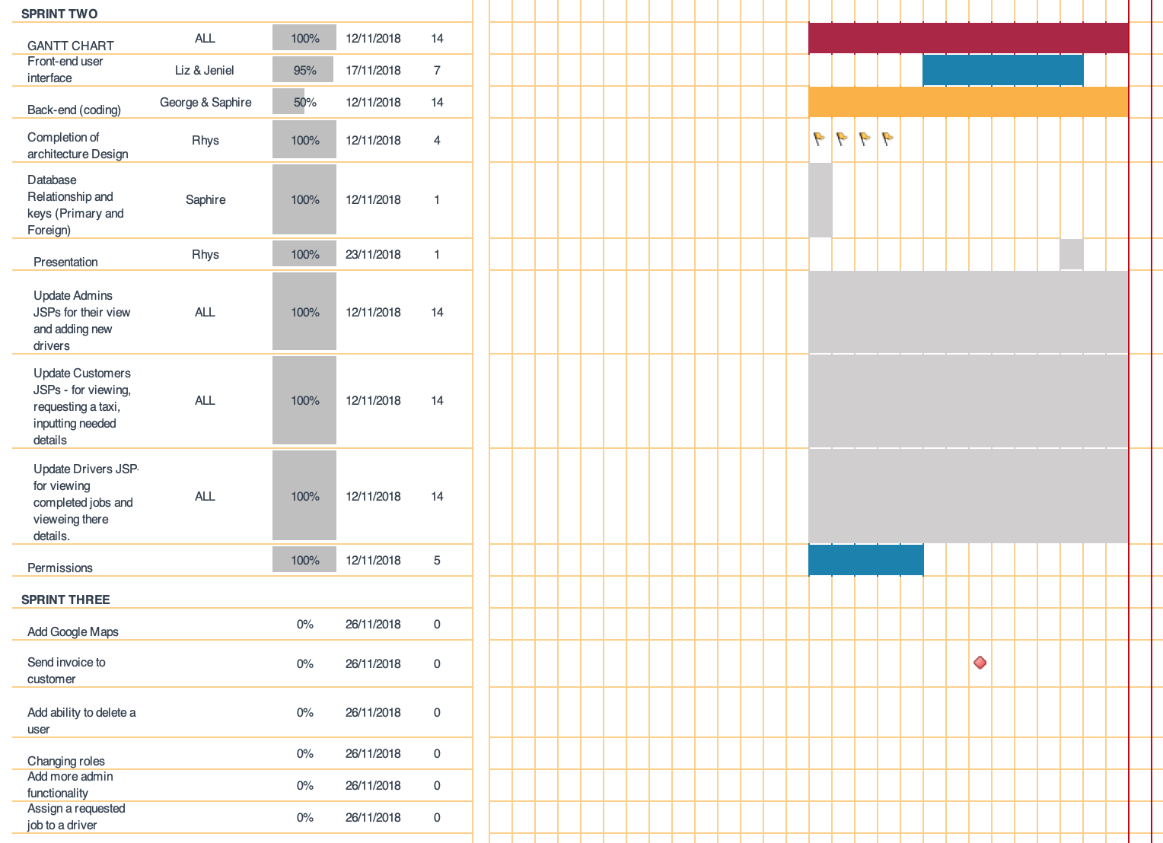
Gant Chart

Slide 5
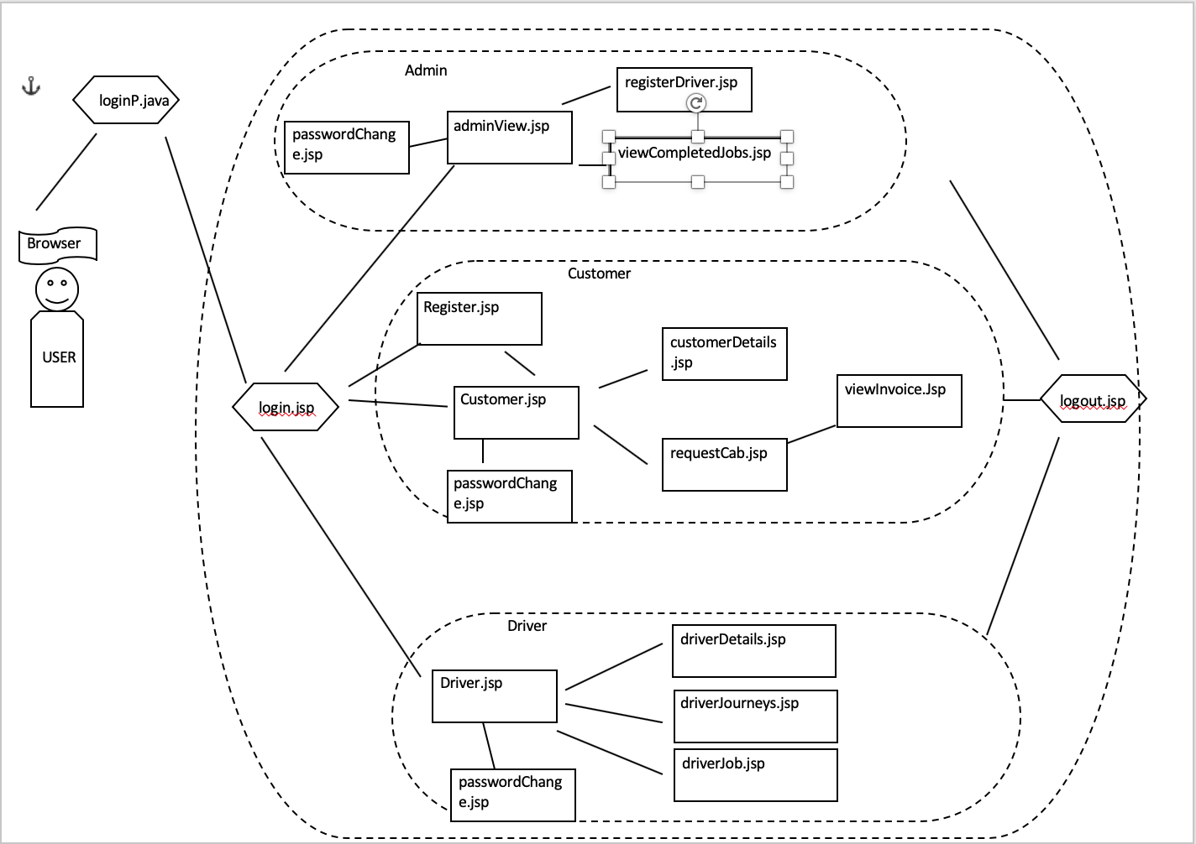
Backend Architecture design

Slide 6
Scrum 1
Identify tasks for sprint 2 .
Allocate tasks to group members.
Created logo for website.
Continued development on front-end user interface

Slide 7
Scrum 2
Discuss progress with project
Update Gantt chart
Fix issues with netbeans/github
Shared a Pizza.

Slide 8
Scrum 3
Completed presentation
Updated Gantt Chart
Updated product backlog
Discussed sprint 3

Slide 9
Product Backlog
Add logo to website - liz
Send invoice to customer – email / on screen – liz & George – email, db,register, customer.jsp
Add ability to use google maps for location. - all
Assign a requested job to a driver - saph
Fix admin delete user – saph, george
Web services - ? – rhys jeniel
Uploading all documents to blackboard when finished. - rhys

